Slide 1


Budget
Zoom
Safety
Smartphone
Google Maps
Facebook
Gmail
Inclusive Digital Academy Agreement No. 2019-1-EN01-KA204-063005
Notes:
Hello to everyone,
Before going into the details of the project, I will briefly introduce myself and our company. Afterwards, Tamer will present the technical details.
My name is Samet Ozmen. I am working at Vakıf Katılım for two years. I am responsible for R&d Center managment. I am a Mechanical Engineer and I did my master's in Industrial engineering. In this project my responsible is financal manangment and to support technical teams of the Project. I will briefly talk about Vakıf Katılım Bank. Then, Tamer will present the technical information of the IDA Project.

Slide 2

SPLASH SCREEN

Slide 3
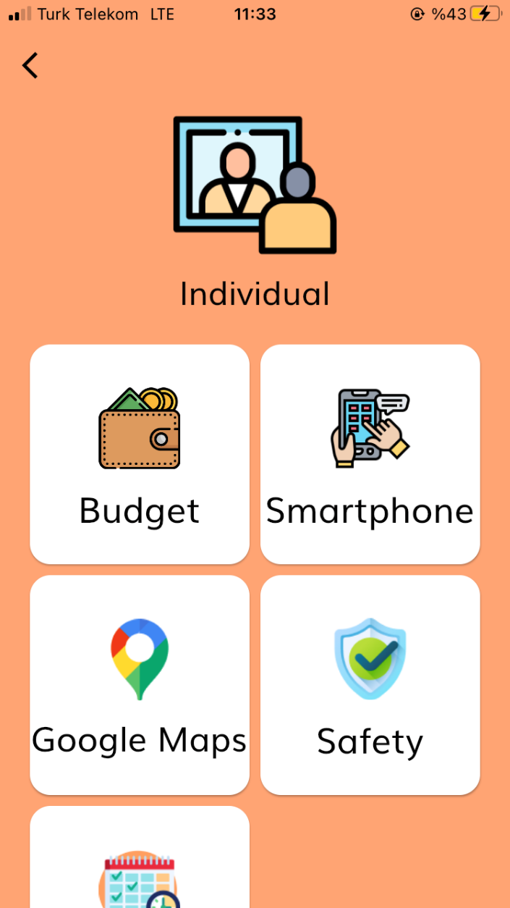
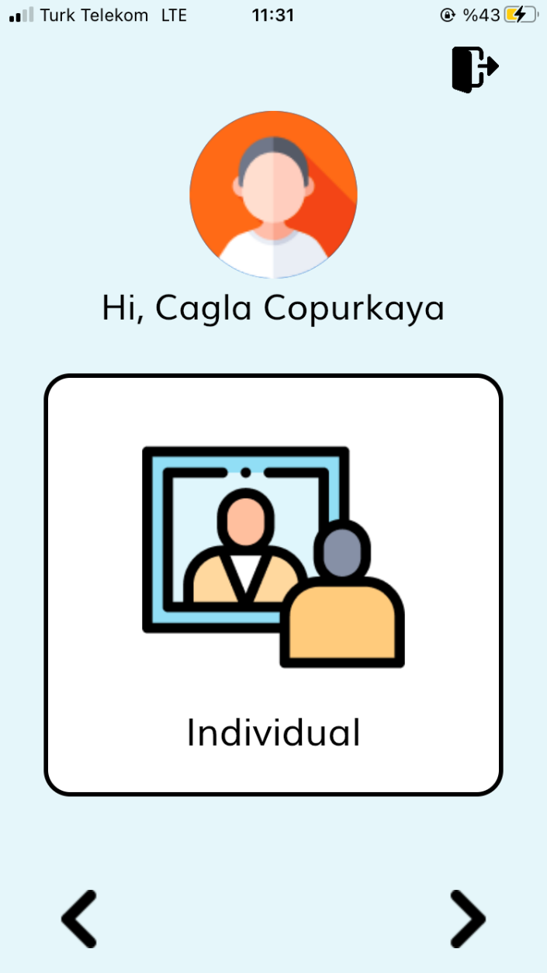
INDIVIDUAL

Slide 4
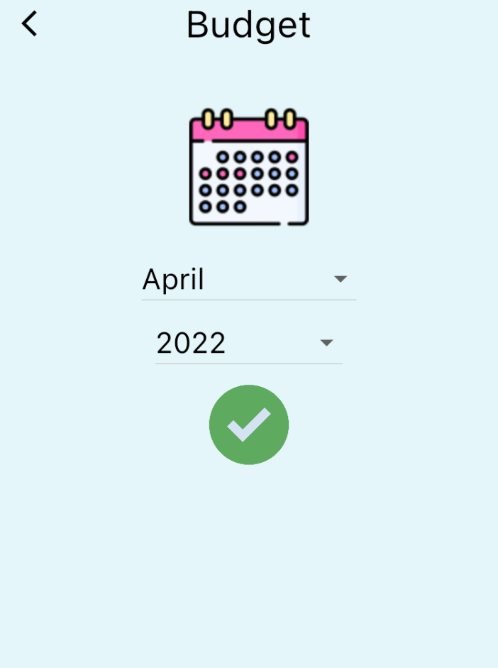
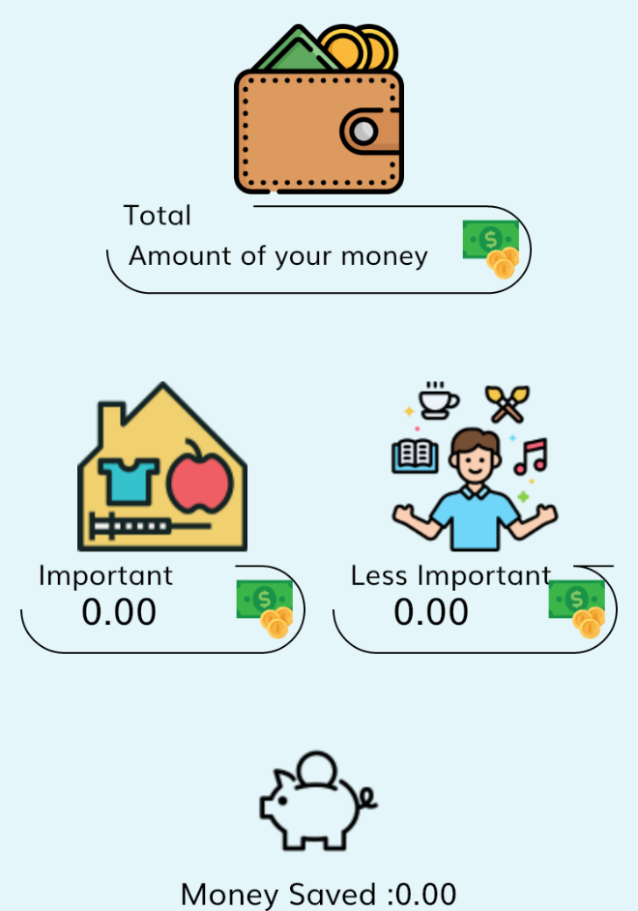
BUDGET
DONE
This package is a package created for PWDs individuals to learn how to budget plan and easily implement it. Thanks to this package, individuals will be able to easily make a budget plan for expenses such as home, health, shopping, transportation, hobby, vacation, and education within the budget plan divided into two parts as important and less important.

Slide 5
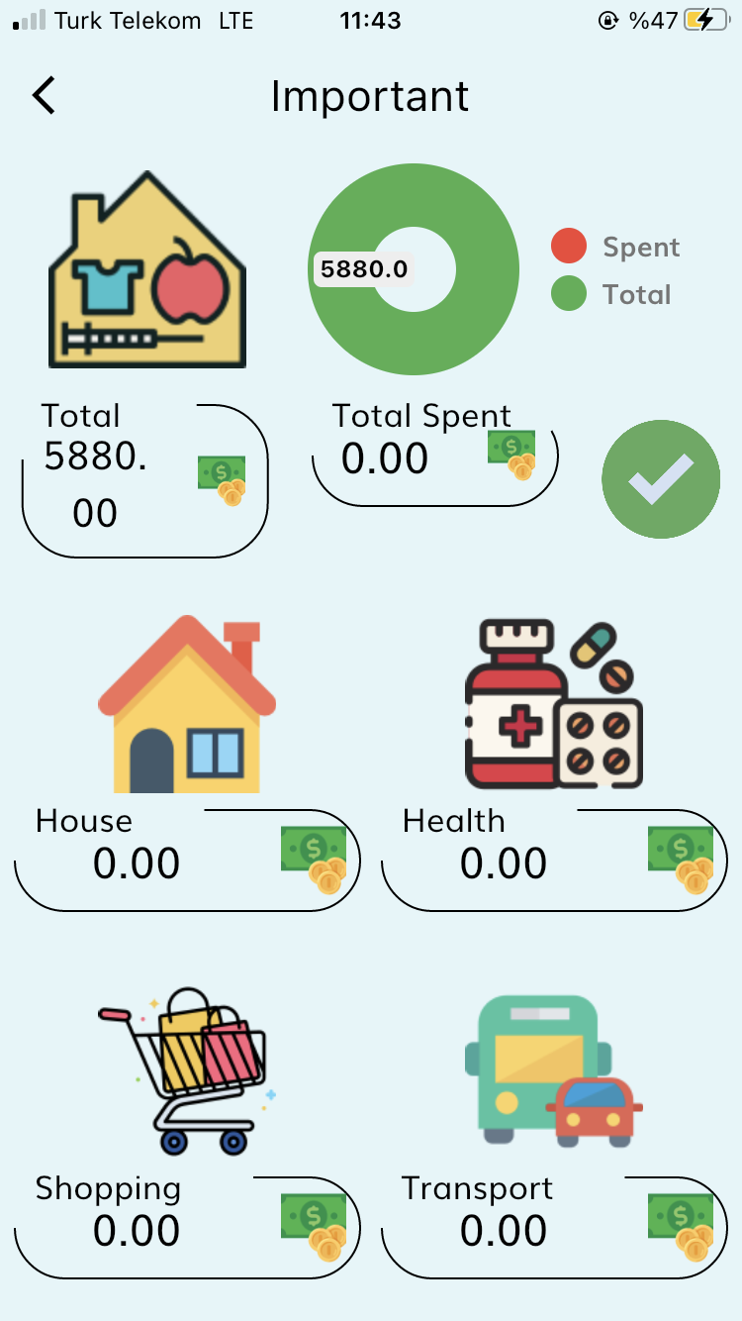
IMPORTANT BUDGET

Slide 6
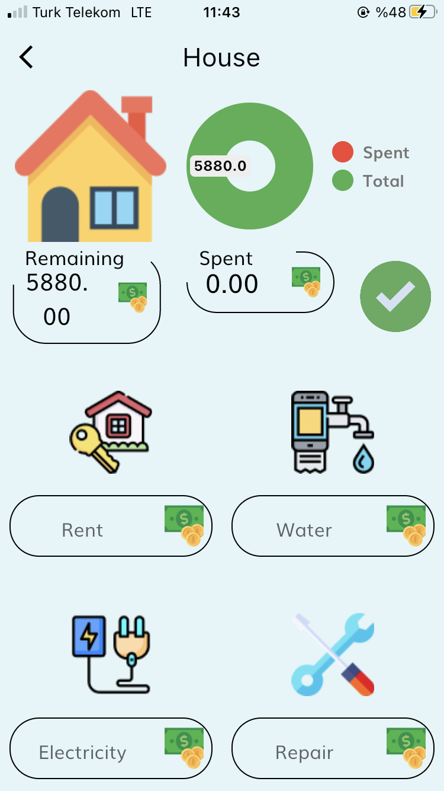
HOUSE BUDGET
In this part, budget planning is made for expenses such as rent, water, electricity, repairs, telephone, natural gas, internet, and subscription.

Slide 7
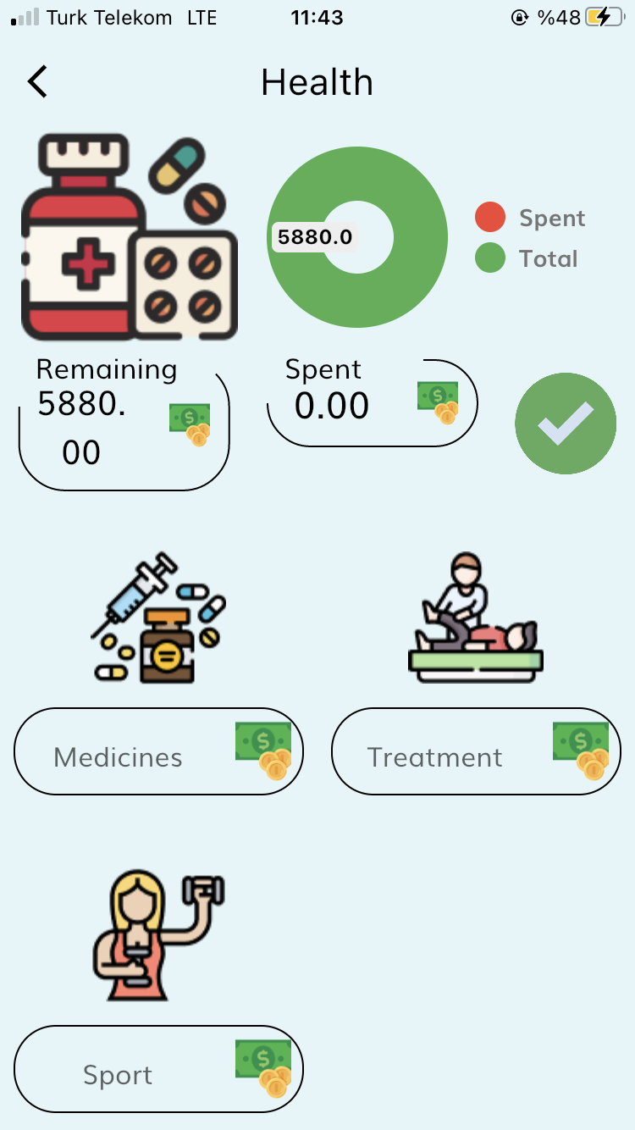
HEALTH BUDGET
In this part, budget planning is made for expenses such as medicines, treatment and sport.

Slide 8
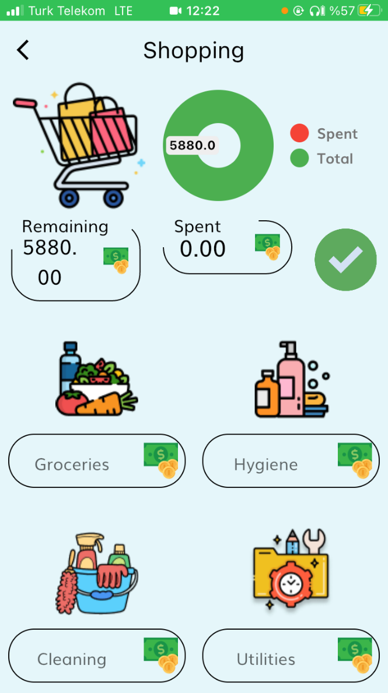
SHOPPING BUDGET
In this part, it can be planned how much monthly budget can be allocated for fruits and vegetables, hygiene products, cleaning products, utilities, clothes, cosmetics and animals.

Slide 9
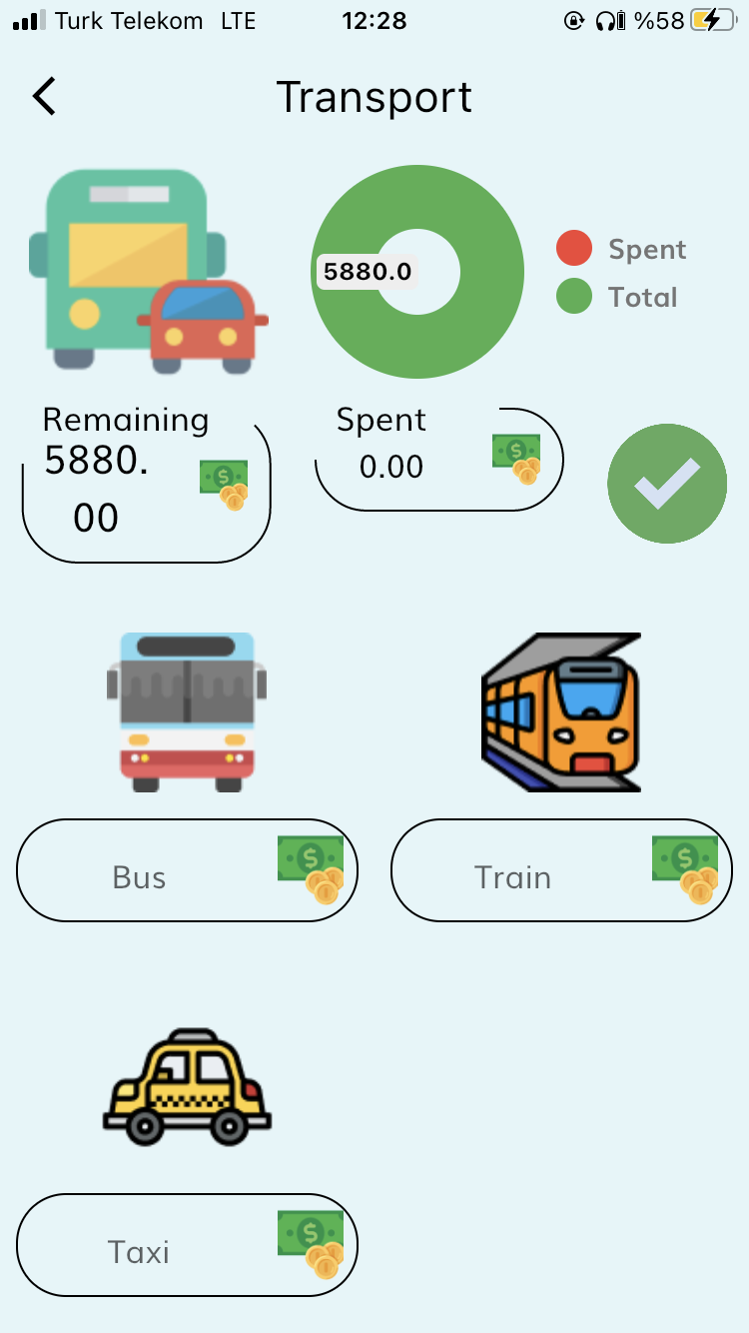
TRANSPORT BUDGET
In this part, it can be planned how much monthly budget can be allocated for bus, train or taxi.

Slide 10
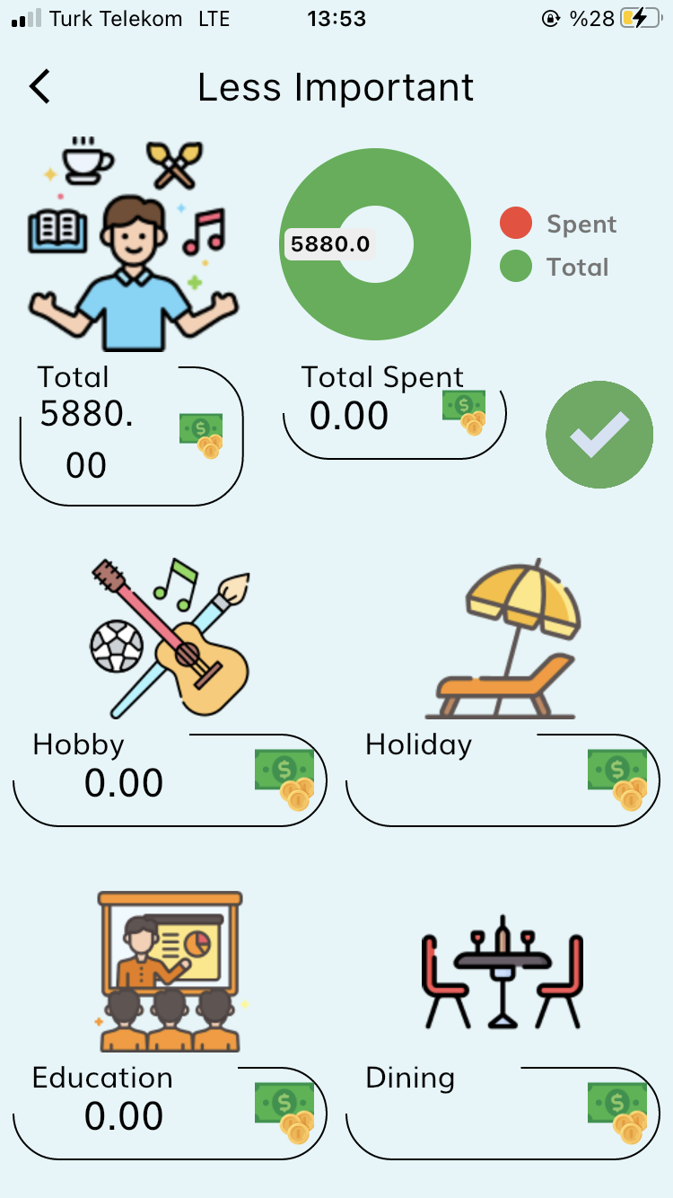
LESS IMPORTANT BUDGET

Slide 11
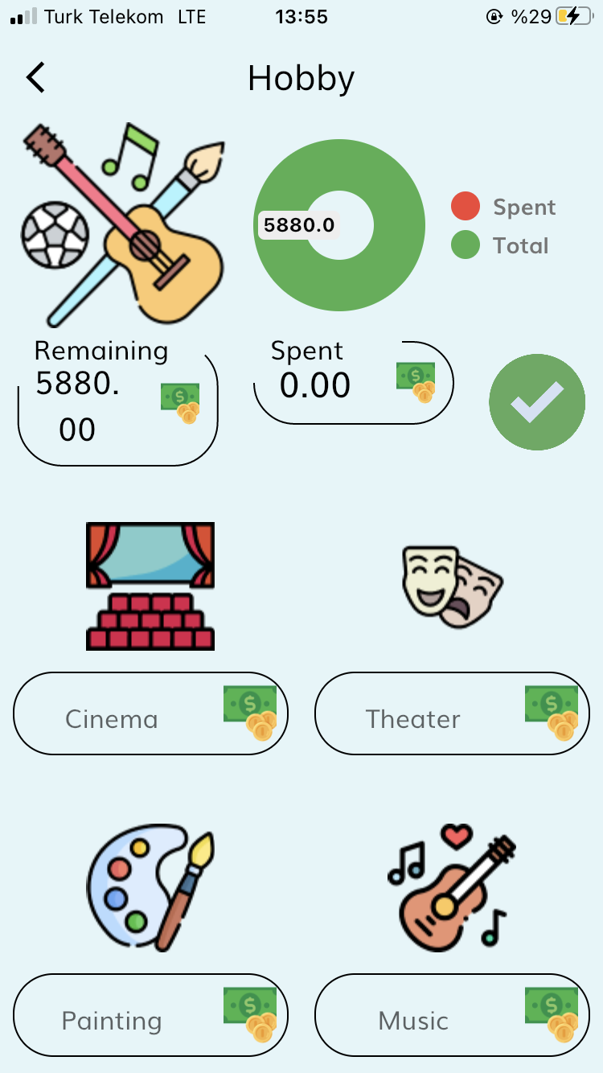
HOBBY BUDGET
In this part, it can be planned how much monthly budget can be allocated for going to cinema, theater, painting materials, music materials.

Slide 12
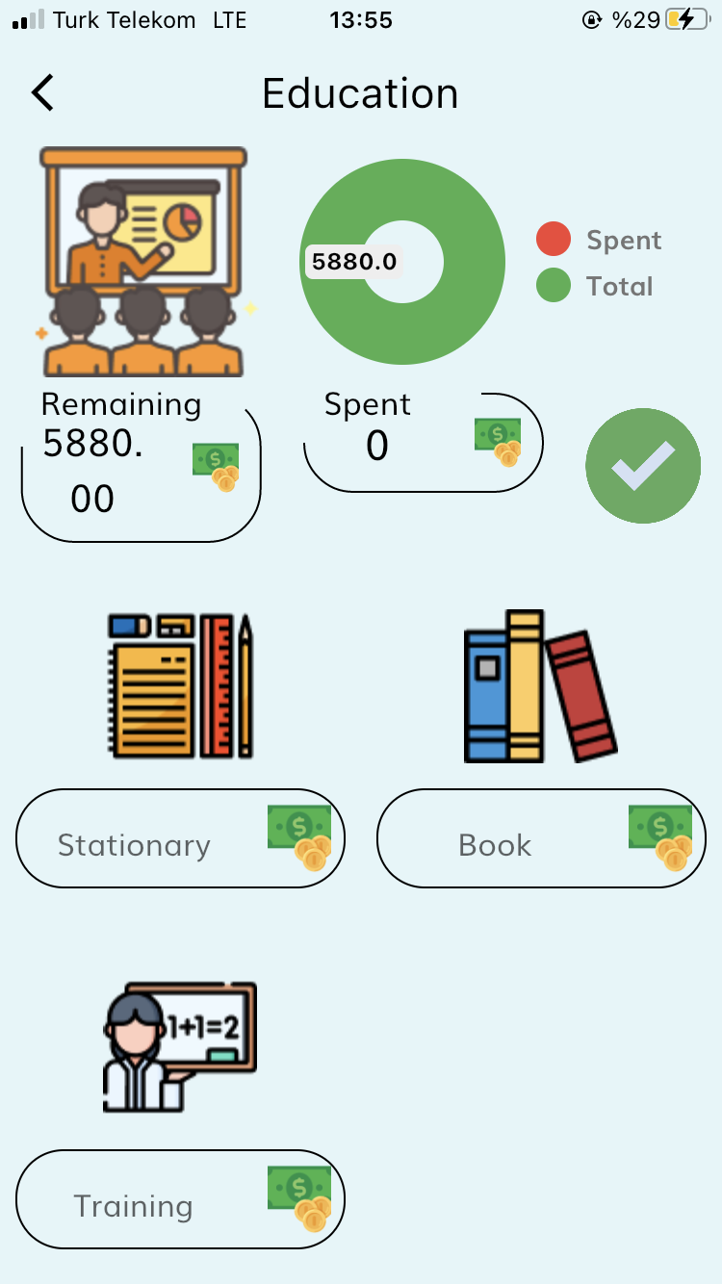
EDUCATION BUDGET
In this part, it can be planned how much monthly budget can be allocated for getting stationary metarials, books, training.

Slide 13
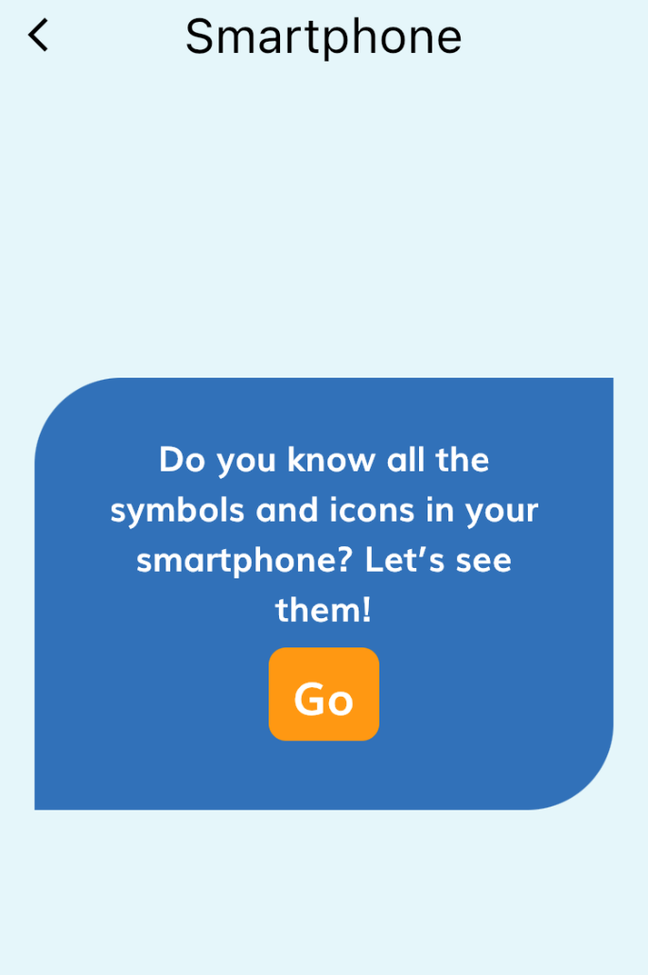
SMARTPHONES
DONE
What do the signs and symbols on phones mean? It is a package that attracts attention with its question and facilitates learning.

Slide 14
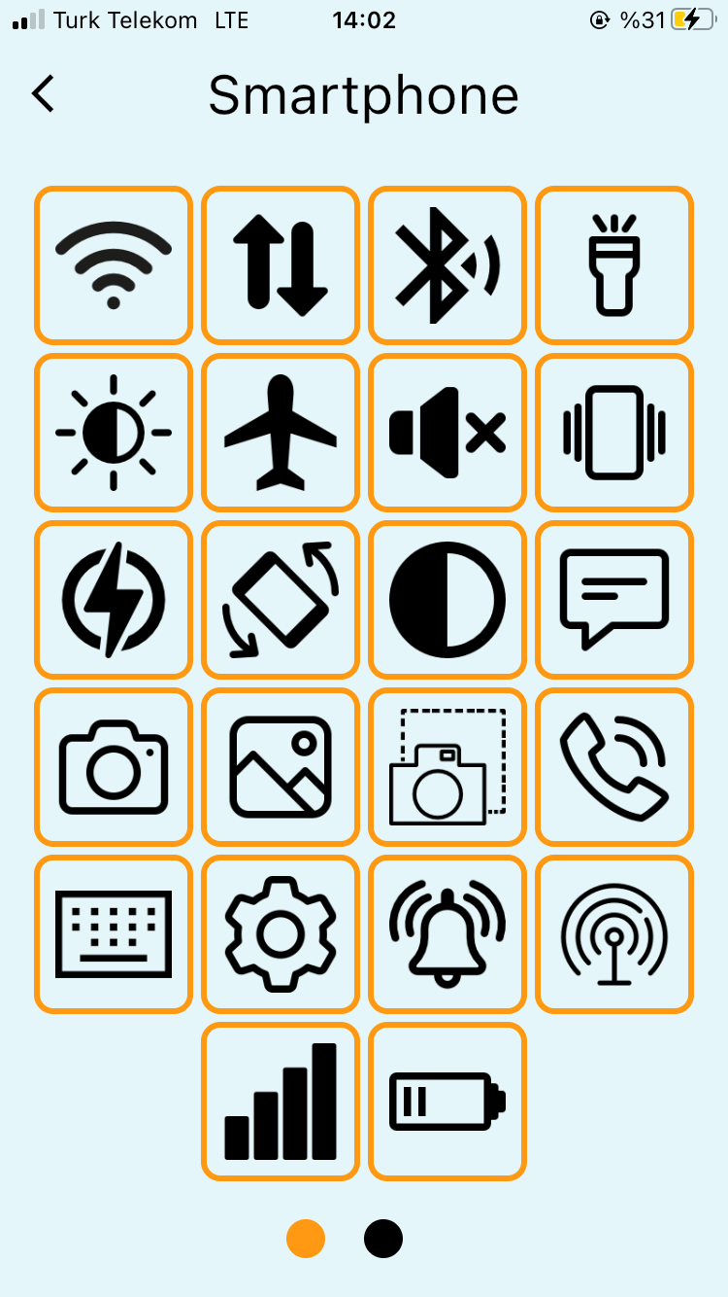
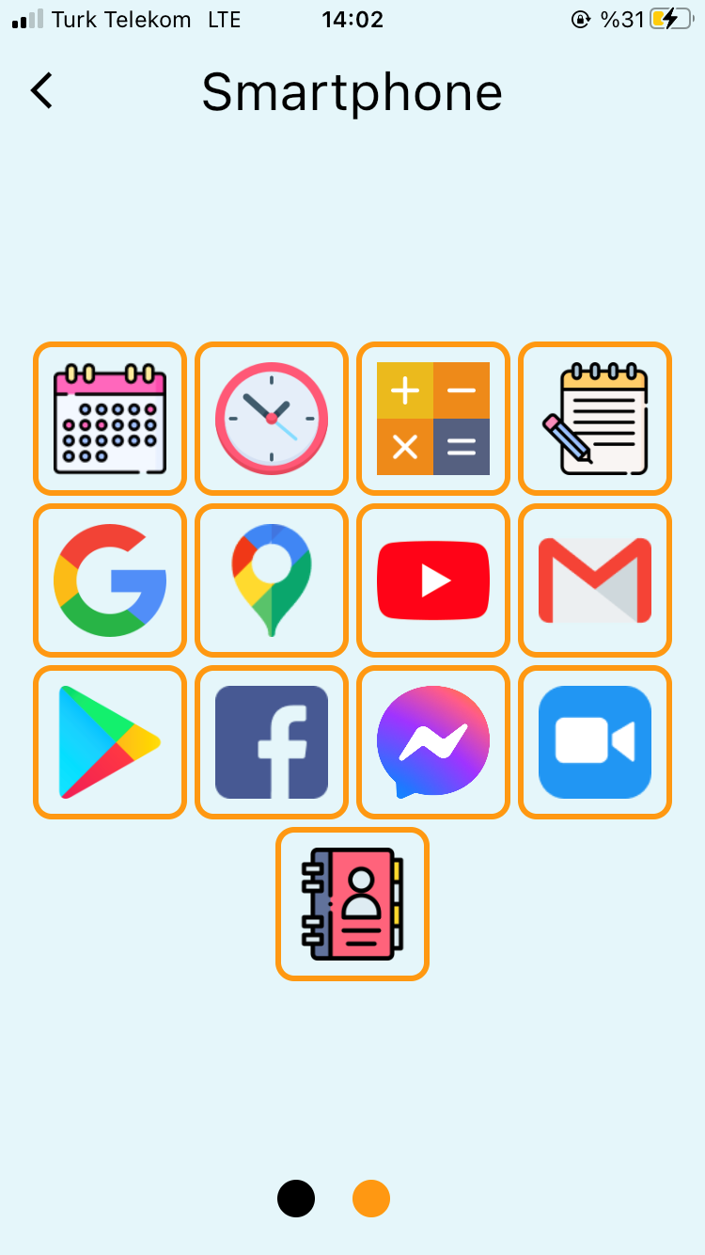
Sign and Symbols in Smartphone Package

Slide 15
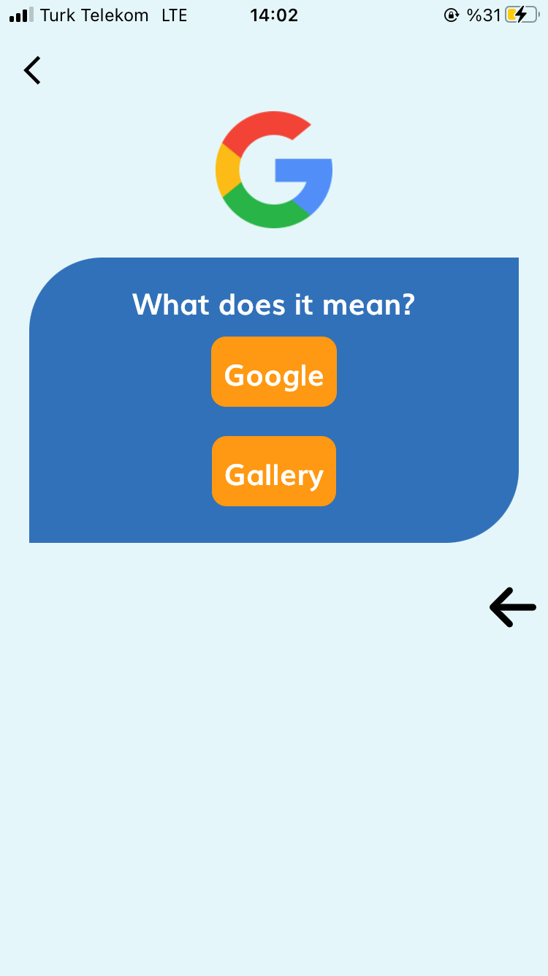
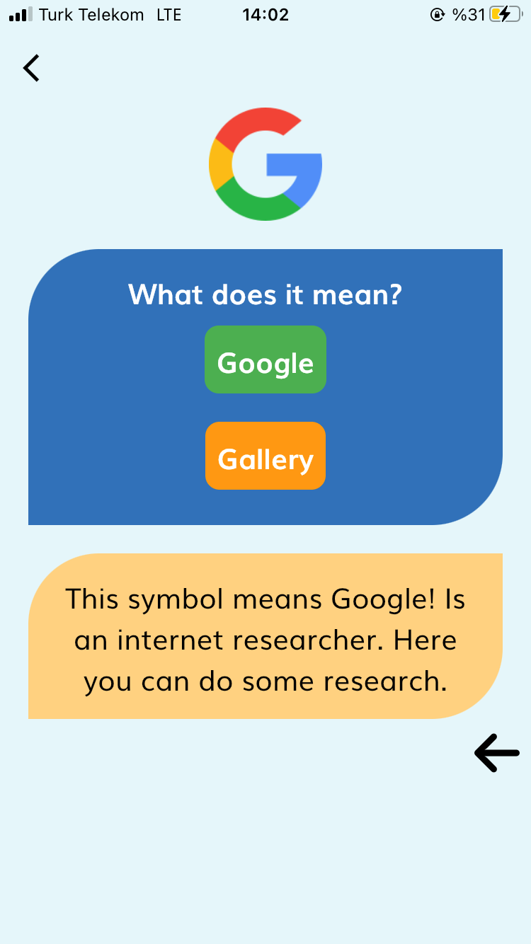
Package Example for Smartphone

Slide 16
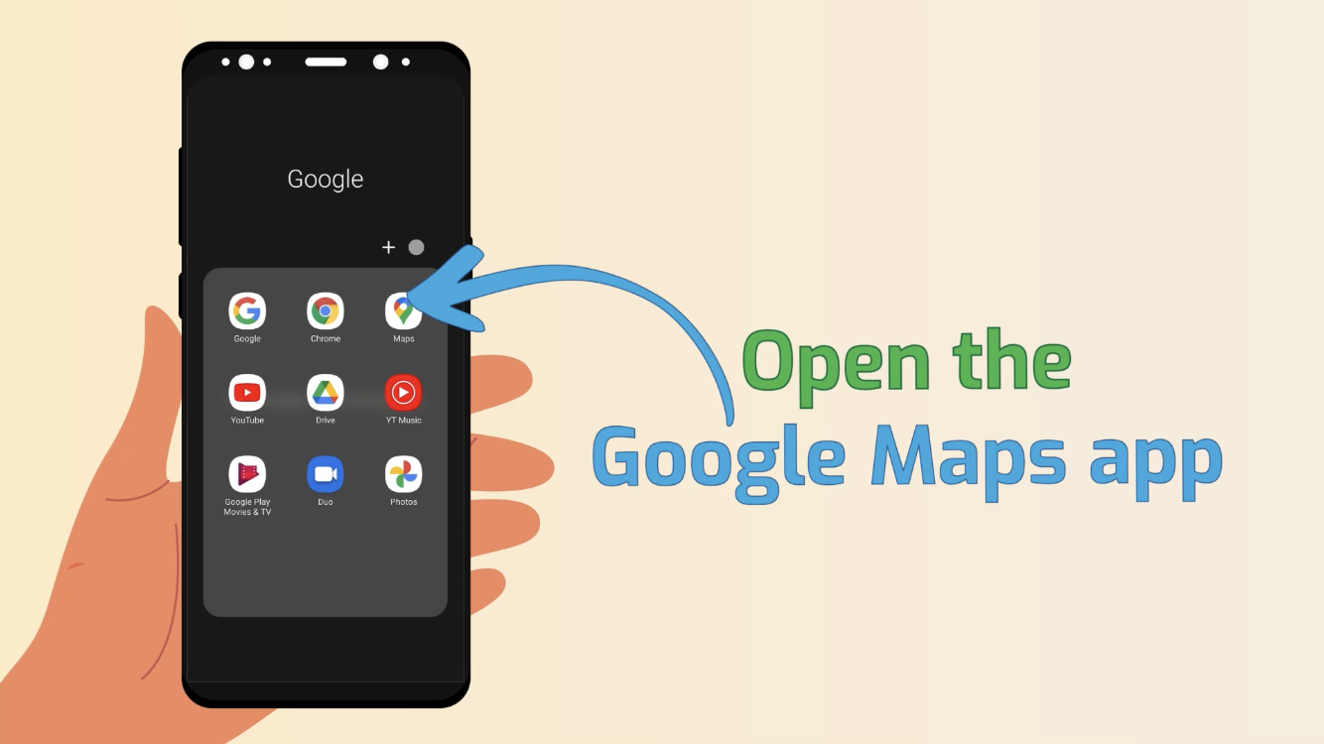
GOOGLE MAPS
DONE
DONE
Google Maps is an application used to find directions. The IDA application, on the other hand, explains how to use the Google Maps application with a video example in this package.

Slide 17
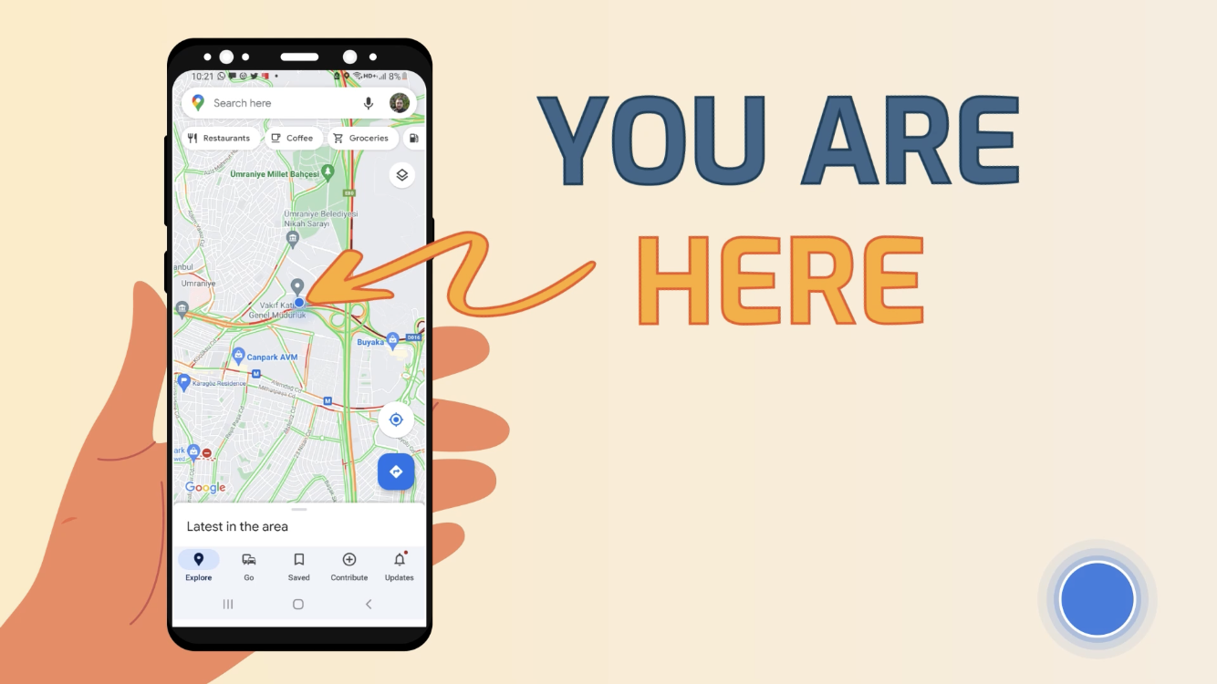
Where am I?

Slide 18
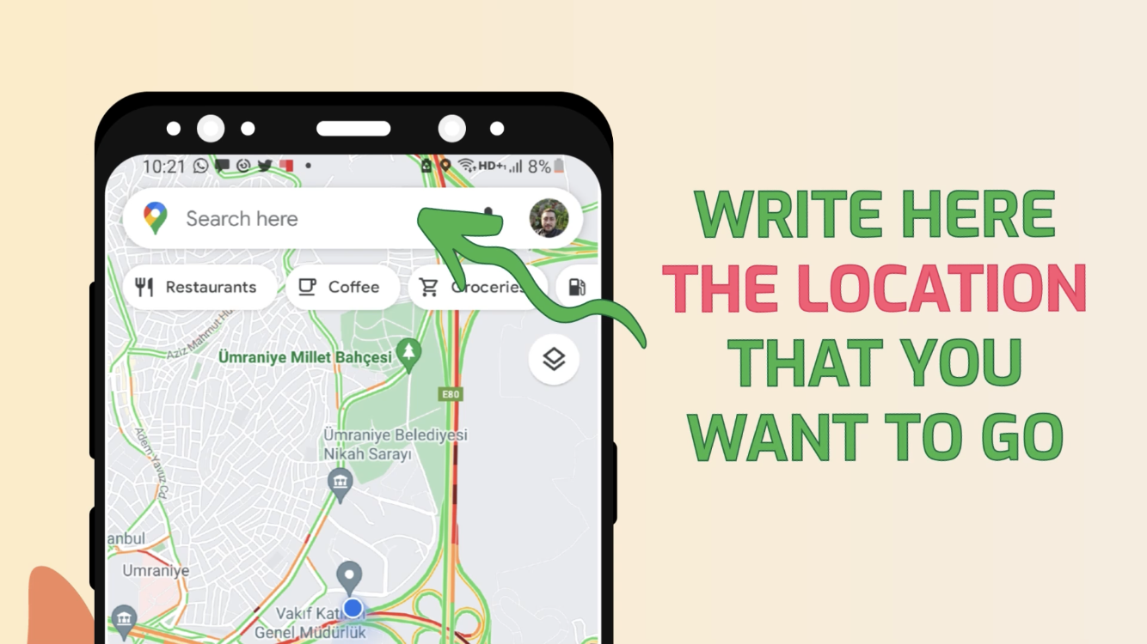
Find a location where you want to go

Slide 19
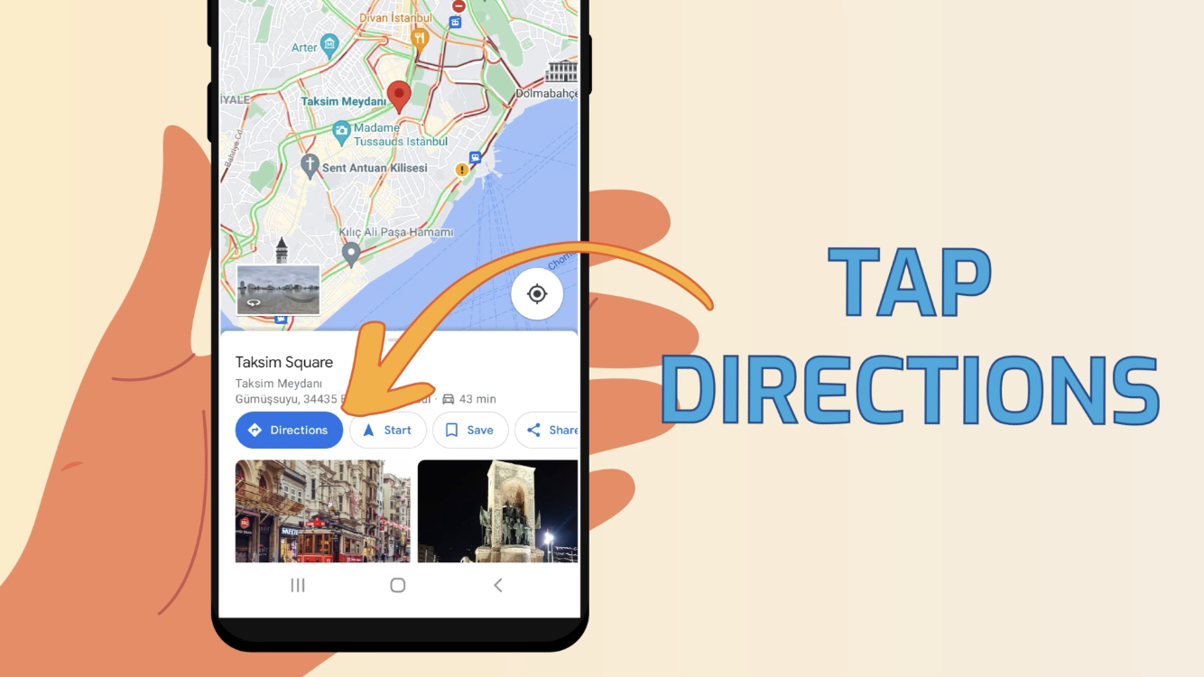
Get direction for location

Slide 20
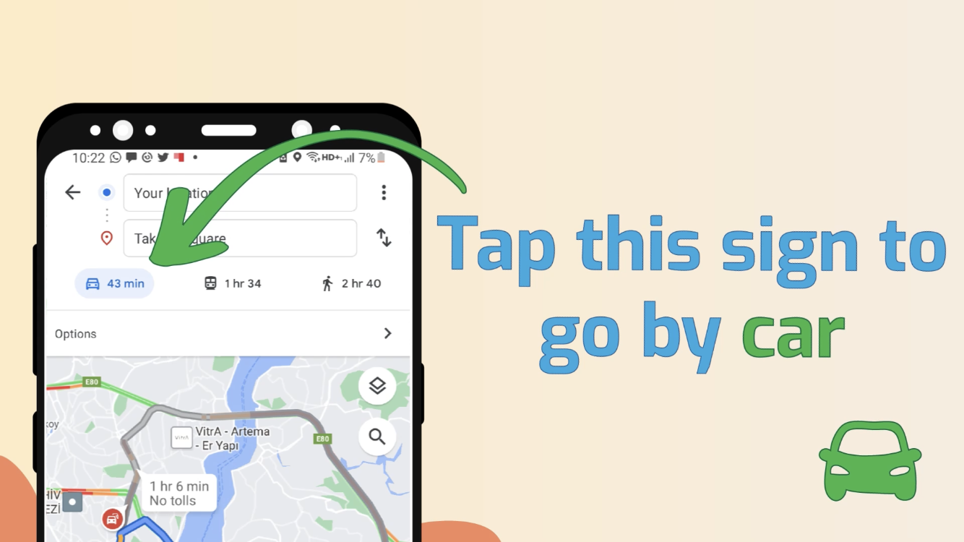
Find a direction with which you want to go by ..

Slide 21
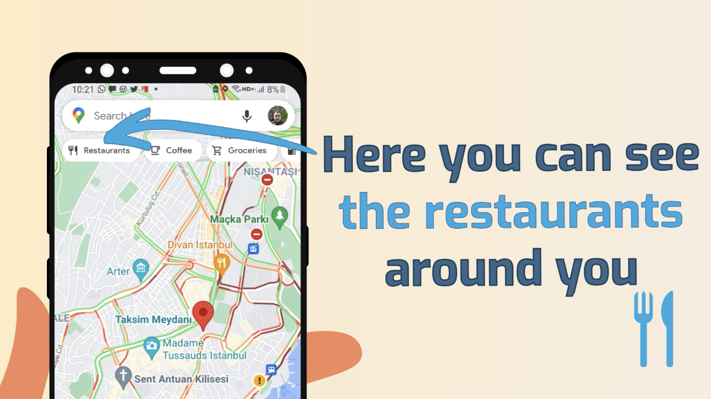
Find restaurants, groceries, hotels etc. around the location

Slide 22
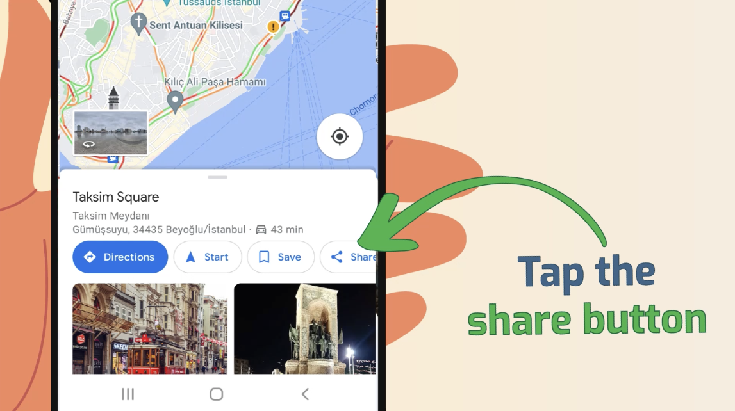
Share location with your friend

Slide 23
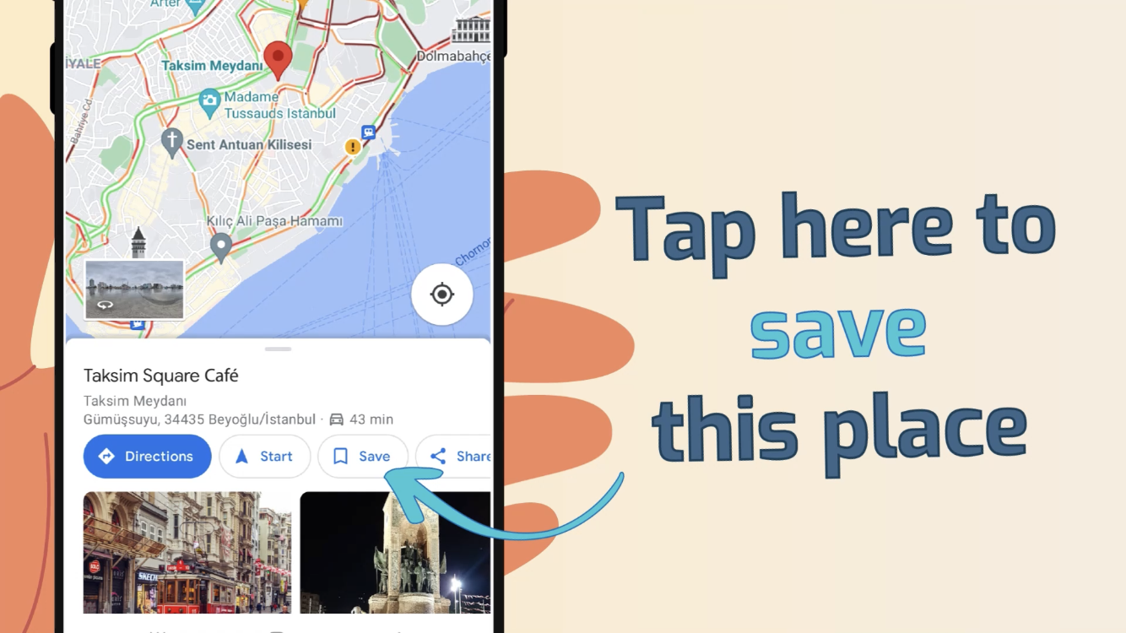
Save location. So you can find it more easily later.

Slide 24
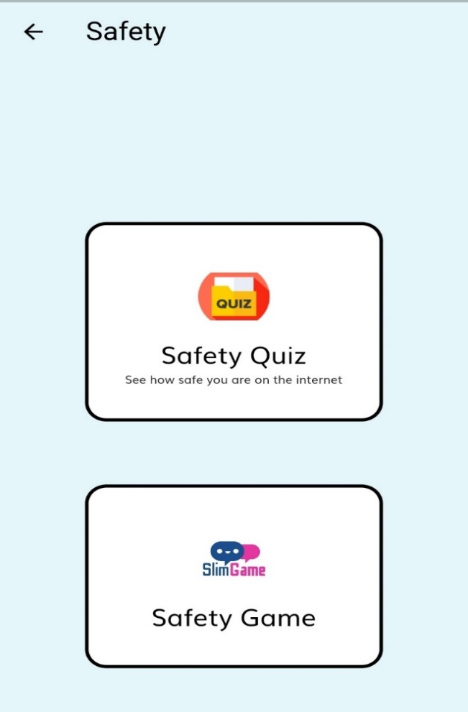
SAFETY
DONE
This two-part pack includes
Safety quiz
Safety board game
It is a package where PWDs ask each other questions about security and try to answer those questions and learn definition.

Slide 25
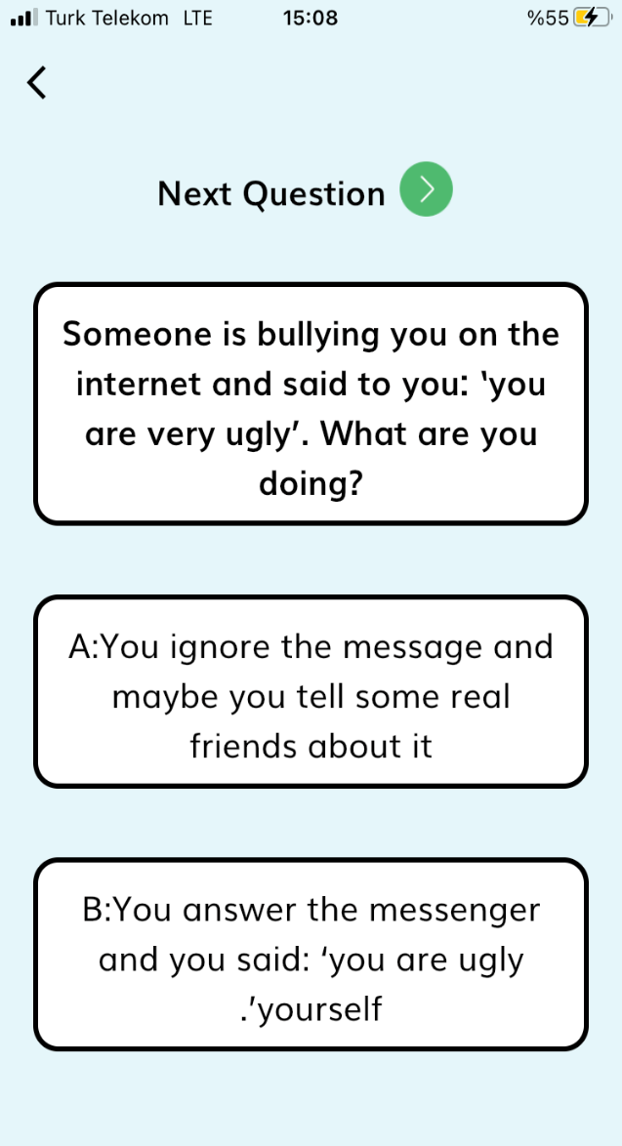
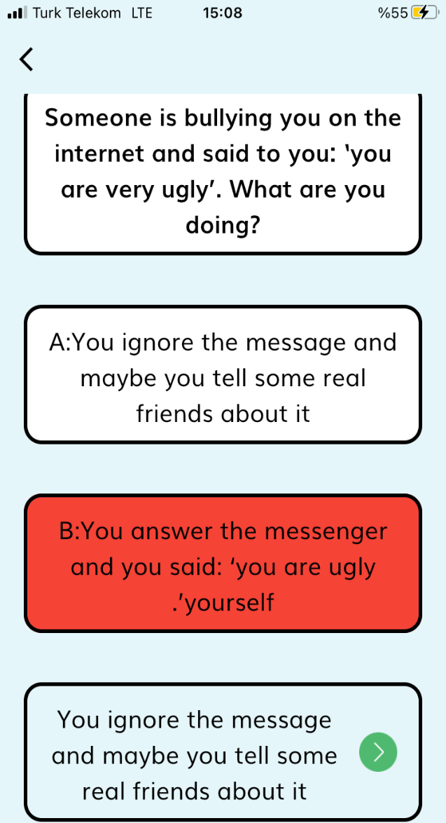
Safety Quiz
This quiz is an instructional quiz package that contains items about what other individuals should do when people who use technology with bad intentions behave badly towards other individuals.

Slide 26
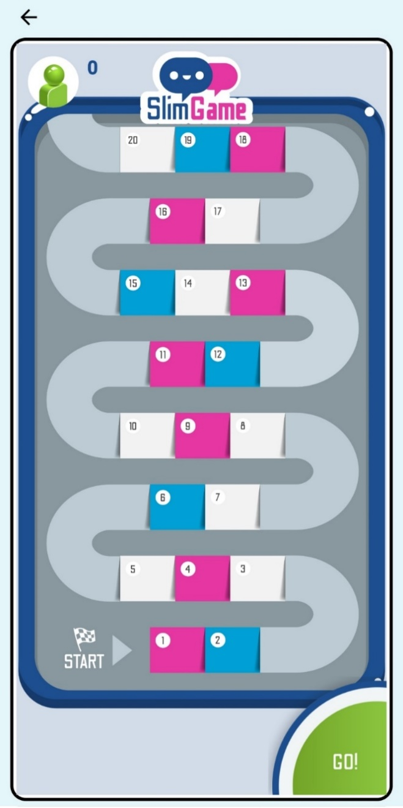
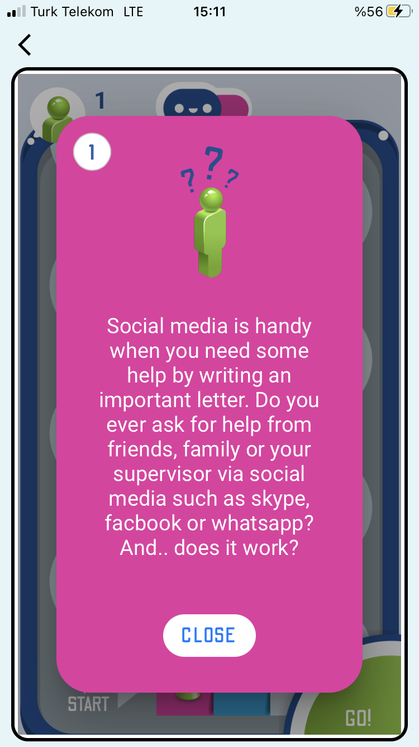
Safety Game
In this part, the person can play the game with 2 or more friends. This part prepared for the person to use the internet safely.

Slide 27
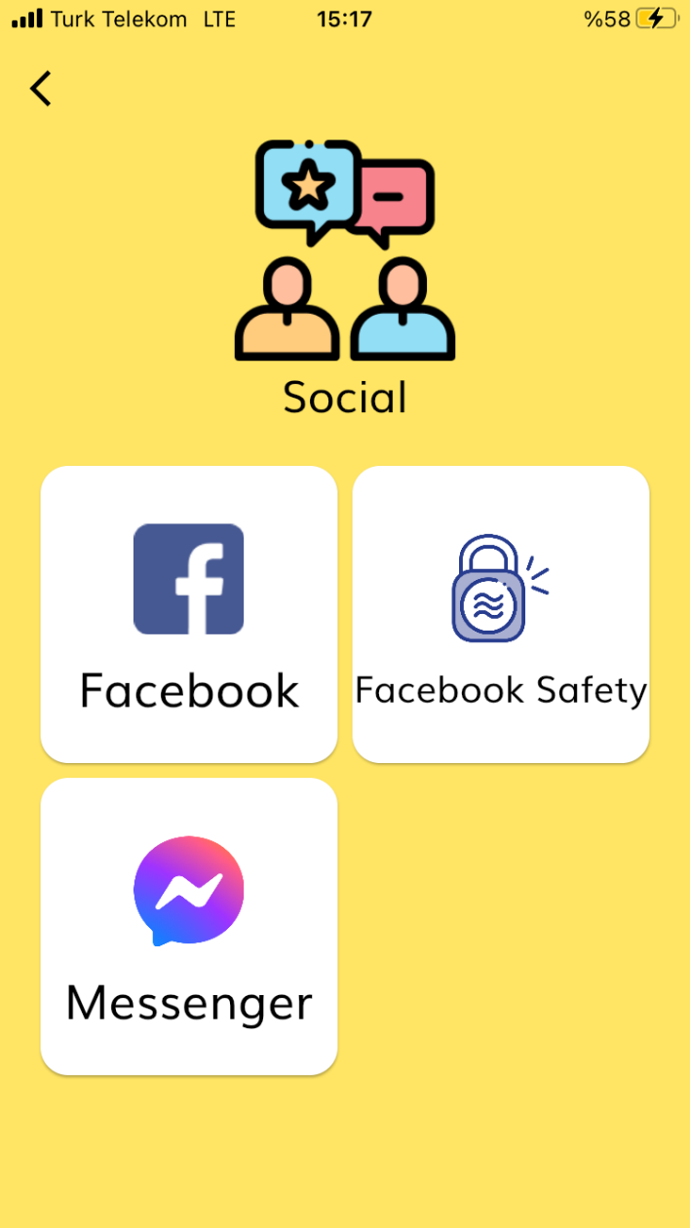
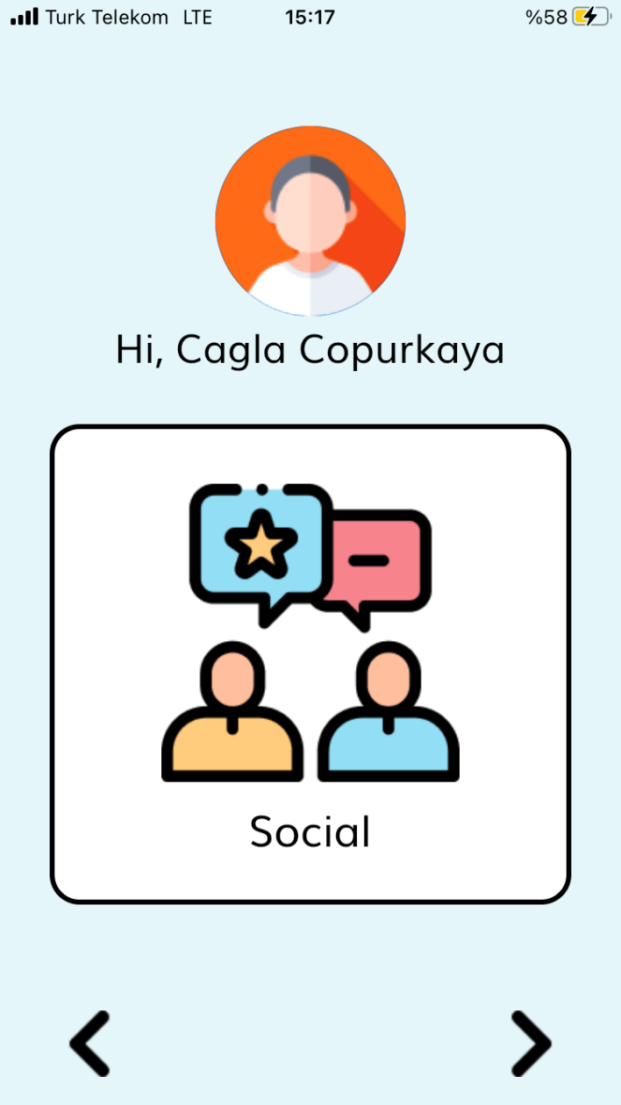
SOCIAL

Slide 28
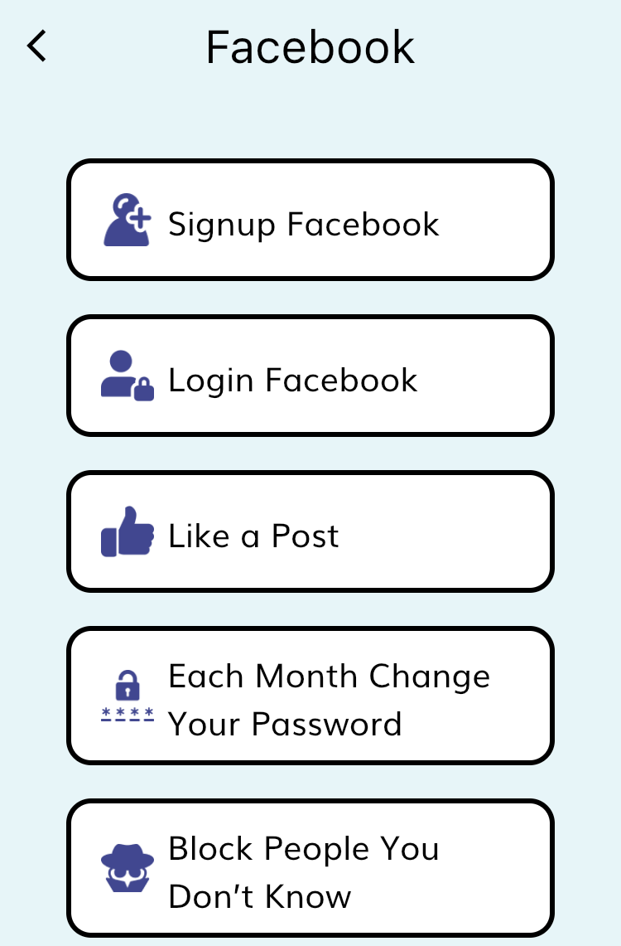
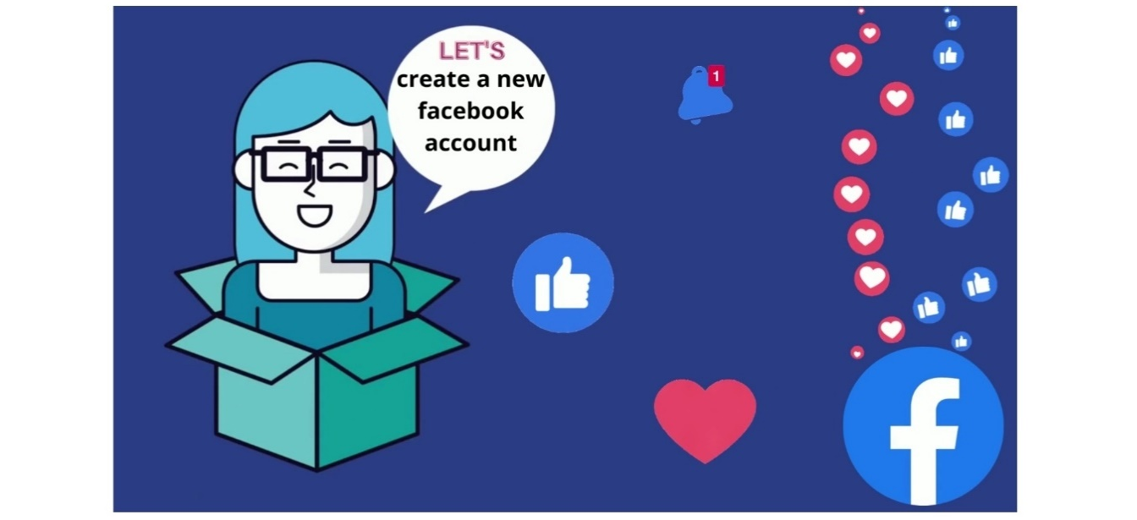
FACEBOOK
DONE
How to use Facebook? What should be considered when using? It is a package that answers these questions and consists of 5 basic content videos. The contents of this package are given below in image on the right.

Slide 29
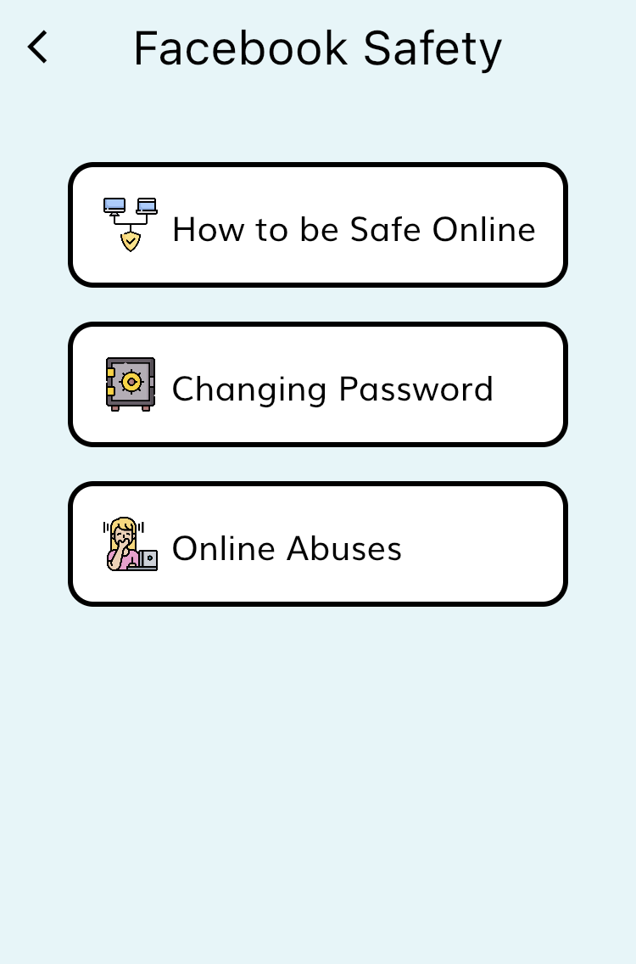
FACEBOOK SAFETY
DONE
How do we protect ourselves against disservice on Facebook? What should we do or not do? It is a package of videos that answer these questions in the most basic way. The contents of this package are given below in image on the right.

Slide 30
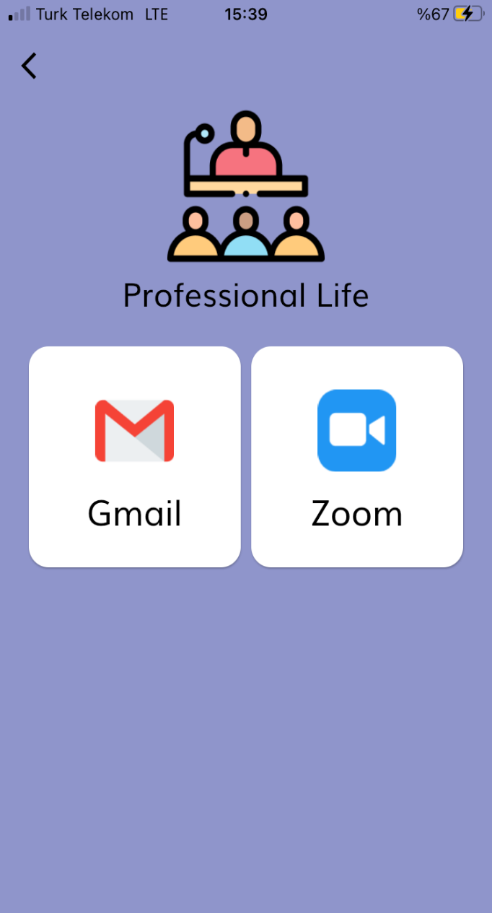
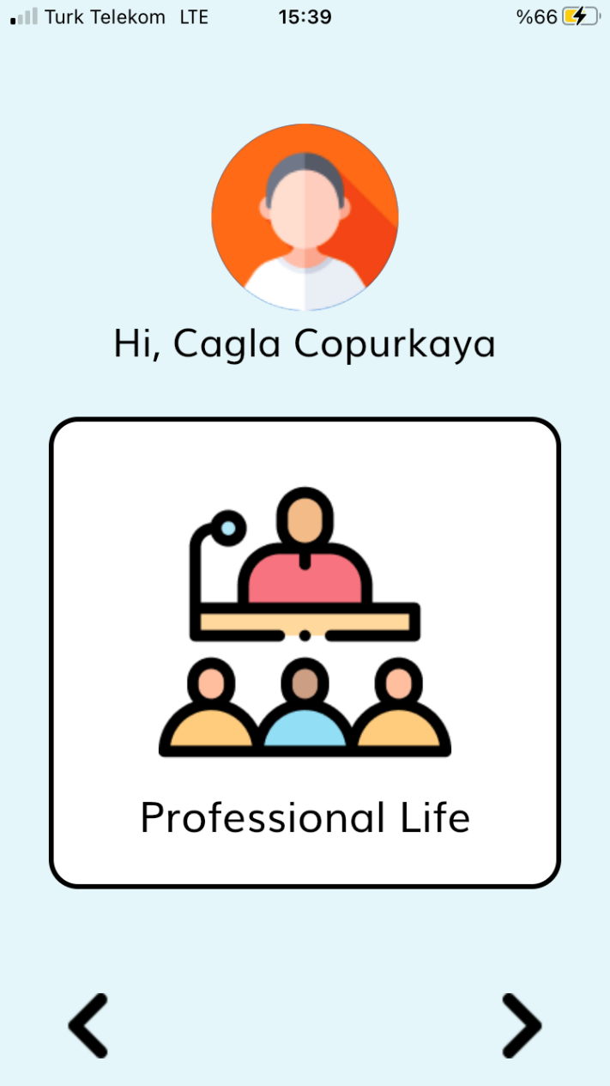
PROFESSIONAL LIFE

Slide 31
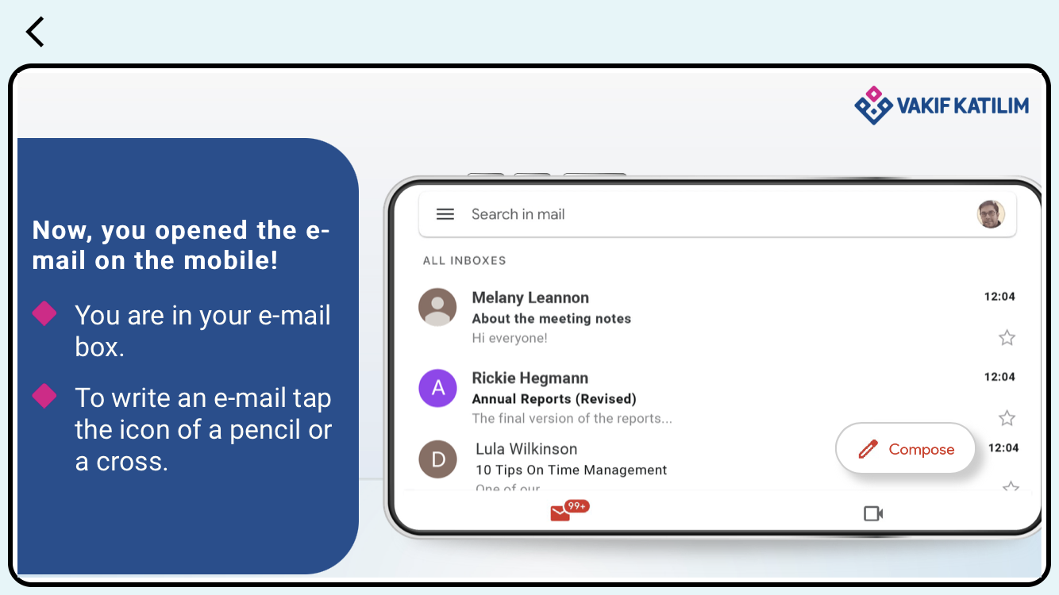
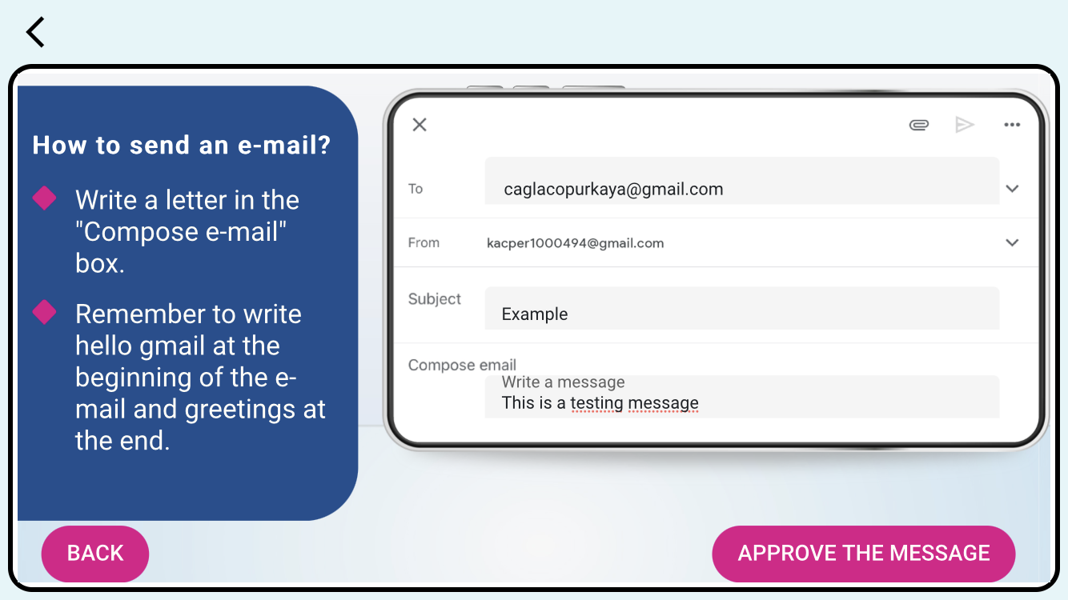
GMAIL
DONE
This is a package that PWDs can learn by simulating how to send a mail.

Slide 32
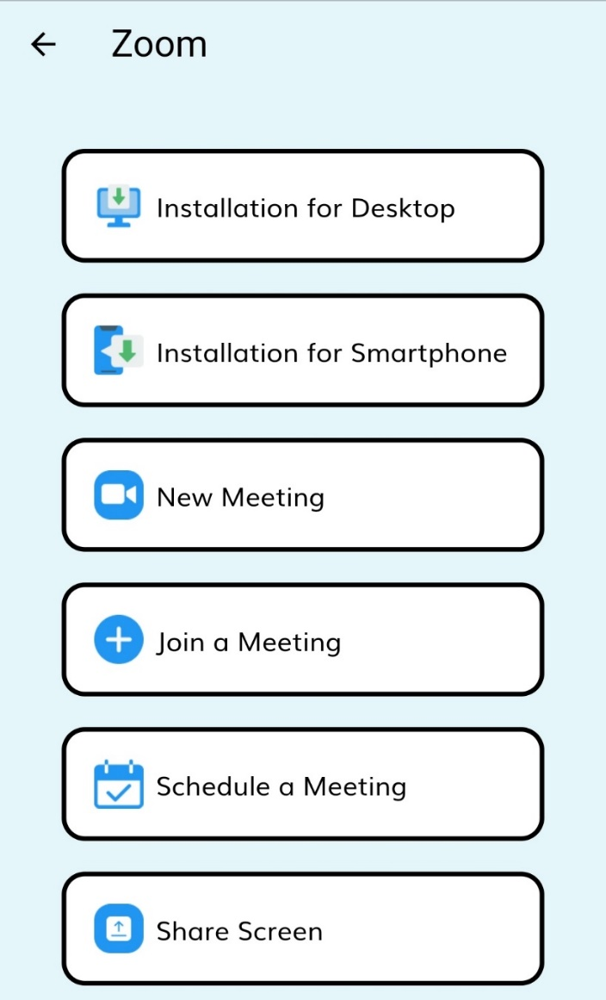
ZOOM
DONE
How do we install zoom? How can we create a new meeting? How can we share our screen? It is a package of videos that answer these questions in the most basic way. It is a package that explains each action separately with videos and teaches how to use the zoom. The contents of this package are given below in image on the right.

Slide 33
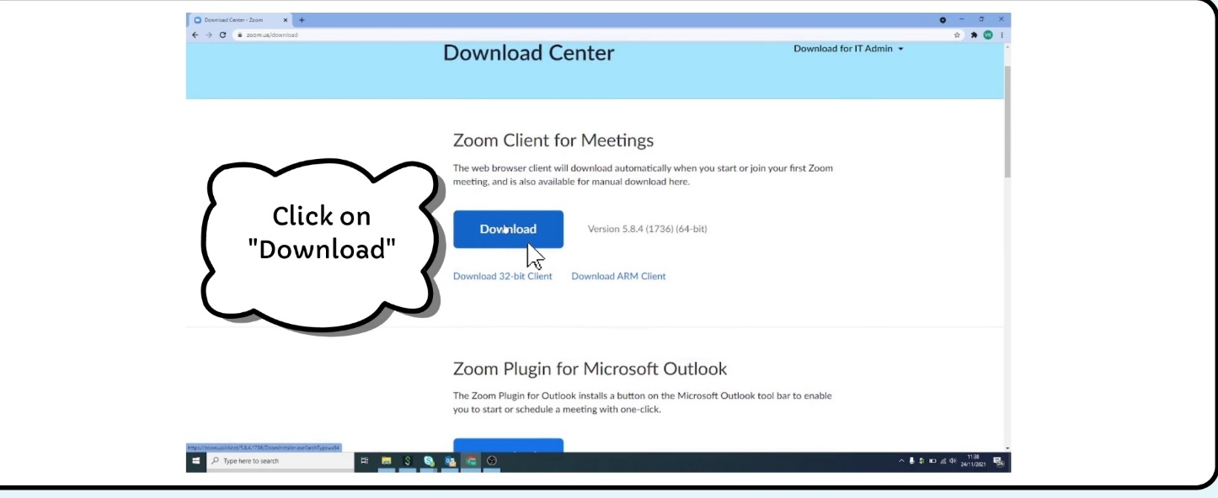
DOWNLOAD ZOOM

Slide 34
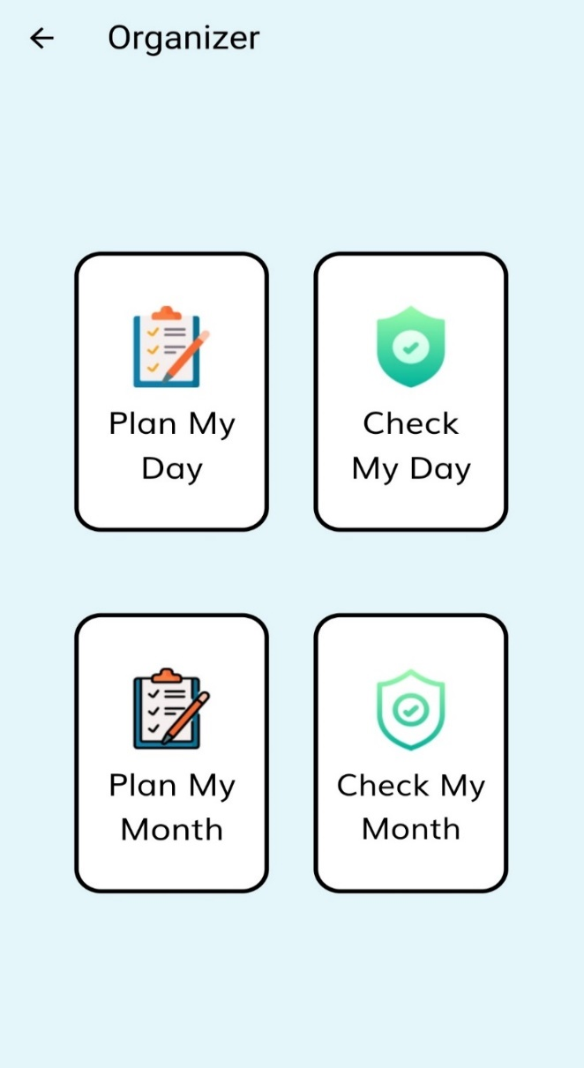
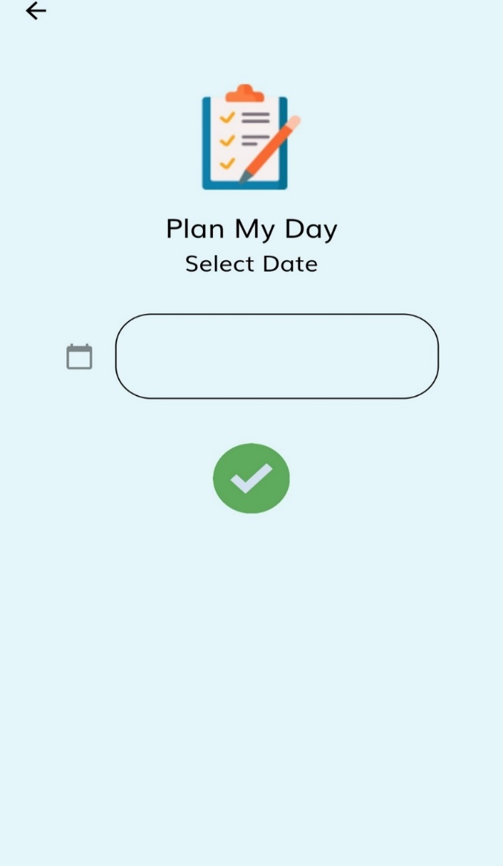
ORGANIZER
IN PROGRESS
It is a package that organizes the day or month of PWDs, can set alarms and send notifications when necessary.

